Slide 1
Electric braking
Powerpoint presentation by:-
Poonam sharma
Lecturer electrical
G.P. manesar

Slide 2
what is braking??
The process of applying brakes can be termed as braking. brake is an equipment to reduce the speed of any moving or rotating equipment, like vehicles, locomotives.
In other words,it is the process of reducing speed of any rotating machine.

Slide 3
CLASSIFICATION OF BRAKING
we can classify the term braking in two parts
Mechanical Braking
Electrical Braking

Slide 4
Mechanical Braking VS ELECTRIC BRAKING
In mechanical braking the speed of the machine is reduced solely by mechanical process but electrical braking is far more interesting than that because the whole process is depended on the flux and torque directions.

Slide 5
Disadvantages of Mechanical Braking
The main disadvantages of the Mechanical Braking are as follows:-
It requires frequent maintenance and replacement of brake shoes.
Braking power is wasted in the form of heat.
Advantageof mechanical braking
it is also used along with the electric braking to ensure reliable operation of the drive. It is also used to hold the drive at the standstill because many braking methods do not produce torque at standstill condition.

Slide 6
Types of Electric Braking
Plugging type braking or reverse current braking
Dynamic braking or Rheostatic braking
Regenerative Braking.

Slide 7
Plugging Type Braking
In this method the terminals of supply are reversed, as a result the generator torque also reverses which resists the normal rotation of the motor and as a result the speed decreases. During plugging external resistance is also introduced into the circuit to limit the flowing current. The main disadvantage of this method is that here power is wasted.

Slide 8
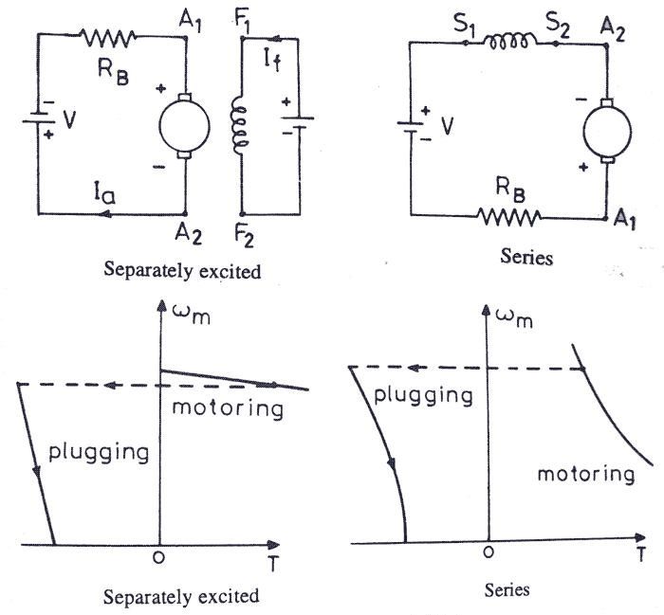
Plugging in d.c shunt and series motor

Slide 9
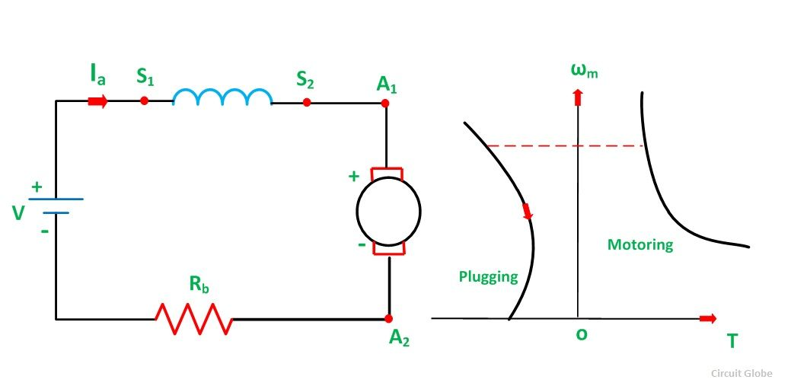
Plugging in d.c series motor

Slide 10
2. Plugging
When the phase sequence of supply of the motor running at speed is reversed by interchanging the connection of any two phases of the stator on the supply terminal, operation change from motoring to plugging as shown in the figure below. Plugging is the extension of motoring characteristic for a negative phase sequence from quadrant third to second. The reversal of phase sequence reverses the direction of a rotating field.

Slide 11
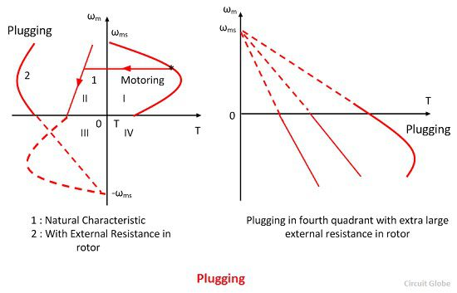
Plugging in induction motor

Slide 12
Plugging induction motor braking is done by reversing the phase sequence of the motor. Plugging braking of induction motor is done by interchanging connections of any two phases of stator with respect of supply terminals. And with that the operation of motoring shifts to plugging braking. During plugging the slip is (2 - s), if the original slip of the running motor is s, then it can be shown in the following way.
From the figure beside we can see that the torque is not zero at zero speed. That’s why when the motor is needed to be stopped, it should be disconnected from the supply at near zero speed. The motor is connected to rotate in the reverse direction and the torque is not zero at zero or any other speed, and as a result the motor first decelerates to zero and then smoothly accelerates in the opposite direction.

Slide 13
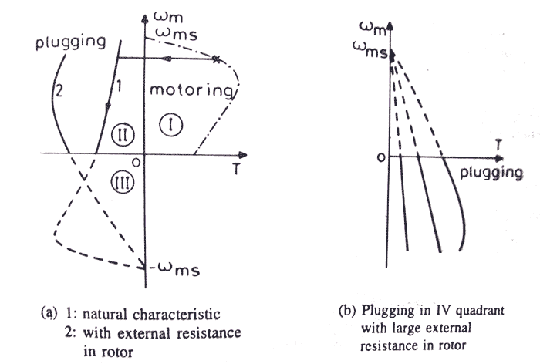
PLUGGING IN INDUCTION MOTOR

Slide 14
PLUGGING IN SYNCHRONOUS MOTORS
The Braking of Synchronous Motor by plugging has serious disadvantages. Very heavy braking current flows causing line disturbances. The torque is also not effective. However, if the motor is synchronous induction type it can be braked effectively by plugging only if the machine is working as an induction motor

Slide 15
Applications of Plugging
The Plugging is commonly used for the following purposes listed below.
In controlling elevators
Rolling Mills
Printing Presses
Machine tools, etc.

Slide 16
Dynamic Braking
Another method of reversing the direction of torque and braking the motor is dynamic braking. In this method of braking the motor which is at a running condition is disconnected from the source and connected across a resistance. When the motor is disconnected from the source, the rotor keeps rotating due to inertia and it works as a self-excited generator. When the motor works as a generator the flow of the current and torque reverses. During braking to maintain the steady torque sectional resistances are cut out one by one.

Slide 17
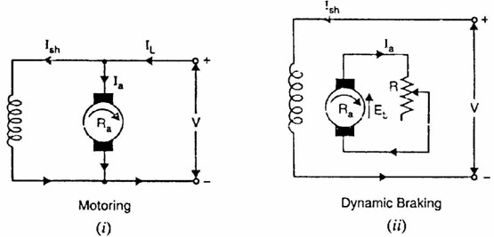
Dynamic braking in dc shunt motor

Slide 18
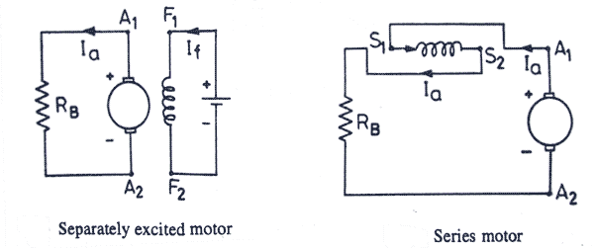
Dynamic braking in dc series and separately excited motor

Slide 19
Dynamic Braking of Induction Motor
This type of induction motor braking is obtained when the motor is made to run on a single phase supply by disconnecting any one of the three phase from the source, and it is either left open or it is connected with another phase. When the disconnected phase is left open, it is called two lead connection and when the disconnected phase is connected to another machine phase it is known as three load connection. The braking operation can be understood easily. When the motor is running on 1-phase supply, the motor is fed by positive and negative sequence, net torque produced by the machine at that point of time is sum of torques due to positive and negative sequence voltage. At high resistance the net torque is found to be negative and braking occurs. From the figure below the two and three load connections can be understood.

Slide 20
Rheostatic or dynamic braking of Synchronous Motor
Synchronous Motor is switched on to a three-phase balanced resistive load after disconnecting it from the mains, keeping the excitation constant. To achieve greater braking torque for effective braking, the excitation may be increased. The terminal voltage and current (change) decrease as the speed decreases. At very low speeds the resistance effect becomes considerable. The value of resistance affects the speed at which the maximum torque occurs. It can ideally be made to occur Just before the stopping of the motor.

Slide 21
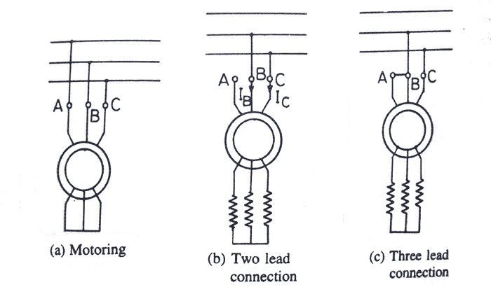

Slide 22
Regenerative braking
• It takes place whenever the speed of the motor exceeds the synchronous speed.
• This baking method is called regenerative baking because here the motor works as generator and supply itself is given power from the load, i.e. motors.
• The main criteria for regenerative braking is that the rotor has to rotate at a speed higher than synchronous speed, only then the motor will act as a generator and the direction of current flow through the circuit and direction of the torque reverses and braking takes place.
• The only disadvantage of this type of braking is that the motor has to run at super synchronous speed which may damage the motor mechanically and electrically, but regenerative braking can be done at sub synchronous speed if the variable frequency source is available.

Slide 23
Regenerative Braking in DC Shunt Motors
Under normal operating conditions the armature current is given by the equation shown below.
When the load is lowered by a crane, hoist or lift causes the motor speed to be greater than the no-load speed. The back EMF becomes greater than the supply voltage. Consequently, armature current Ia becomes negative. The machines now begin to operate as a generator.

Slide 24
Regenerative Braking in DC Series Motors
In case of DC Series Motor an increase in speed is followed by a decrease in the armature current and field flux. The back EMF Eb cannot be greater than the supply voltage. Regeneration is possible in DC Series Motor since the field current cannot be made greater than the armature current.
Regeneration is required where DC Series Motor is used extensively such as in traction, elevator hoists etc. For example – In an Electro-locomotive moving down the gradient, a constant speed may be necessary. In hoist drives the speed is to be limited whenever it becomes dangerously high.
One commonly used method of regenerative braking of DC Series Motor is to connect it as a shunt motor. Since the resistance of the field winding is low, a series resistance is connected in the field circuit to limit the current within the safe value.

Slide 25
Regenerative Braking of Induction Motor
We know the power (input) of an induction motor is given as.
P_{in} = 3VI_{s}cosφ_{s}Here, φ_{s} the phase angle between stator phase voltage V and the stator phase current I_{s}.
For motoring operation φ_{s} < 90º and for braking operation φ_{s} > 90º.
When the speed of the motor is more than the synchronous speed, relative speed between the motor conductors and air gap rotating field reverses, as a result the phase angle because greater than 90º and the power flow reverse and thus regenerative braking takes place.
It the source frequency is fixed then the regenerative braking of induction motor can only take place if the speed of the motor is greater than synchronous speed, but with a variable frequency source regenerative braking of induction motor can occur for speeds lower than synchronous speed. The main advantage of this kind of braking can be said that the generated power is use fully employed and the main disadvantage of this type of braking is that for fixed frequency sources, braking cannot happen below synchronous speeds.

Slide 26
ADVANTAGES &DISADVANTAGES
The main advantage of this kind of braking can be said that the generated power is use fully employed
The main disadvantage of this type of braking is that for fixed frequency sources, braking cannot happen below synchronous speeds.

Slide 27
REGENERATIVE BRAKING IN SYNCHRONOUS MOTOR
When the motor operates as a variable speed drive motor utilizing a variable frequency supply, it can be regeneratively braked and all the K.E. returned to the mains. As in an induction motor, regeneration is possible if the syn­chronous speed is less than the rotor speed. The input frequency is gradually decreased to achieve this at every instant. The KE. of the rotating parts is returned to the mains. The braking takes place at constant torque.

Slide 28
Applications of Regenerative Braking
Regenerative braking is used especially where frequent braking and slowing of drives is required.
It is most useful in holding a descending load of high potential energy at a constant speed.
Regenerative braking is used to control the speed of motors driving loads such as in electric locomotives, elevators, cranes and hoists.
Regenerative braking cannot be used for stopping the motor. It is used for controlling the speed above the no-load speed of the motor driving.

